Slide 1
UE20CS971– Project Phase – 2
End Semester Assessment
Project Title : CREATING A AGRIBOT BY IMPLEMENTING BERT MODEL ON RASA FRAMEWORK
Project Guide : Shankar DK

Slide 2
Agenda
Problem Statement
Abstract and Scope
Rasa Components
BERT in RASA Framework
Dataset Information
Methodology
Advantages
Conclusion

Slide 3
Problem Statement
The aim of this project is to improve the accuracy and effectiveness of Agribot by using the BERT model on Rasa framework. Specifically, we will train a BERT-based model on a Agriculture dataset to improve the chatbot's ability to understand and respond to user queries related to the Agriculture, such as cost, insect control, soil testing, Government schemes,Fertilizers etc..

Slide 4
Abstract and Scope
In this project, we aim to improve the accuracy of natural language processing (NLP) in chatbots by implementing the BERT model on Rasa framework (BERT model is a powerful pre-trained language model that has revolutionized the field of natural language processing, The Rasa framework, on the other hand, is an open-source machine learning framework that is specifically designed for building conversational AI). We will be using a Agriculture dataset to train the BERT model and integrate it with Rasa to create a chatbot that can answer Agriculture-related questions. The proposed methodology involves preprocessing the dataset, fine-tuning the BERT model, and integrating it with Rasa to create a conversational AI that can provide accurate information on Agriculture Questions. The expected outcomes of this project are to create a chatbot that can answer Agriculture-related questions accurately and efficiently, and to demonstrate the effectiveness of BERT model on Rasa framework for NLP tasks.

Slide 5
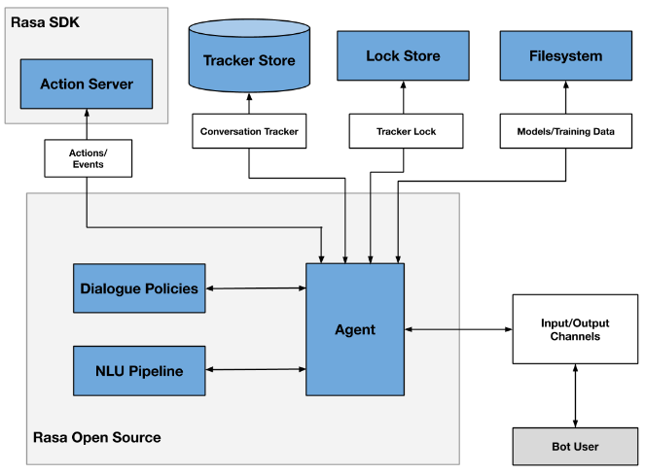
Abstract and Scope
The two primary components are Natural Language Understanding (NLU) and dialogue management.
NLU is the part that handles intent classification, entity extraction, and response retrieval. It's shown below as the NLU Pipeline because it processes user utterances using an NLU model that is generated by the trained pipeline.
The dialogue management component decides the next action in a conversation based on the context. This is displayed as the Dialogue Policies in the diagram.

Slide 6
BERT in Rasa Framework
Bidirectional Encoder Representations from Transformers (BERT) is a state-of-the-art natural language processing (NLP) model that has shown superior performance in various NLP tasks, including text classification and named entity recognition (NER). In this implementation, BERT is used as a pre-trained model for the DIETClassifier, which is a neural network architecture used for intent classification and entity recognition.The DIETClassifier uses a pre-trained BERT model, which has been trained on a large amount of data using unsupervised learning techniques to learn general language representations. During training, the DIETClassifier fine-tunes the pre-trained BERT model to your specific task, such as intent classification and entity extraction. This implementation provides a practical guide for integrating BERT into the Rasa framework, enabling developers to build more sophisticated and effective conversational AI applications.

Slide 7
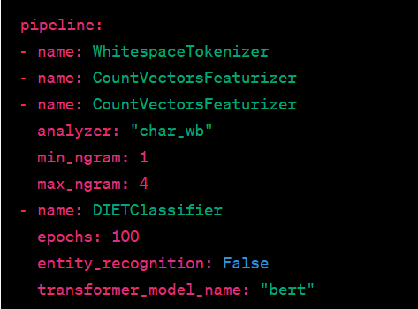
Installing rasa and Configuring BERT
Go to Command prompt
pip install rasa
pip install spacy
rasa init –no-prompt(This creates a new project )
pip install -r requirements.txt
pip install "rasa[transformers]“
Next step is to open the config.yml file and add the pipeline part that is relevant for NLU model training and hence don't declare any dialogue policies.

Slide 8
Stages of making AGRIBOT with the RASA framework
Activation of RASA,
Create a Chatbot folder to store all files and insert them into the folder
Install RASA
After the installation process is complete, the init RASA process is carried out,
Create Intent and Entity on nlu.yml and stories.yml to enter all words that will be used later by the Bot and user,
Create a response for each utter on domain.yml
Configure the DIET Classifier in config.yml
Conduct training data
Test the chatbot

Slide 9
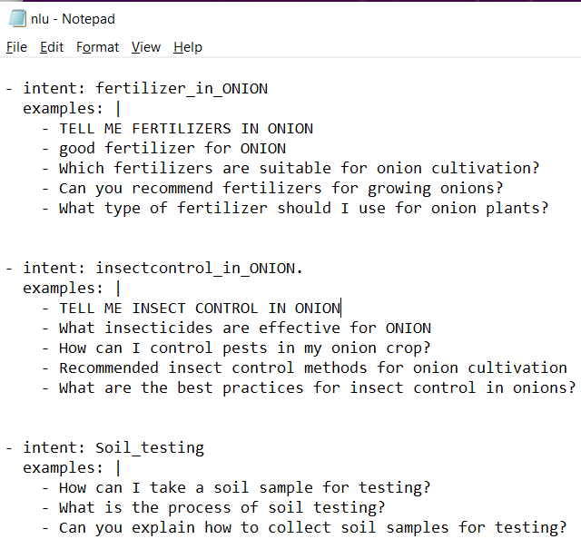
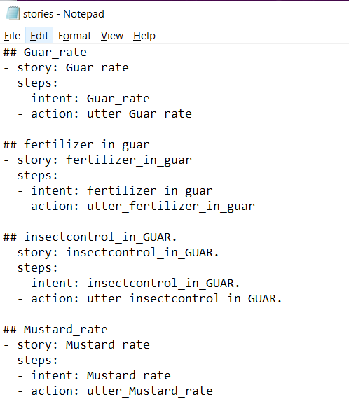
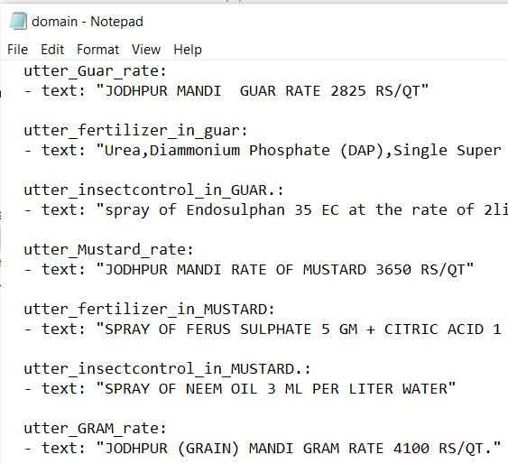
Training dataset Preparation
Identify the intent and entity from the query
nlu.yml file has all the intent and corresponding query text
story.yml file has all the systematic way of conversation including intent and actions
domain.yml file has intent, action, response and query answer

Slide 10
Methodology
Data Collection: Collect a Agriculture dataset that contains questions related to the Agriculture and its questions, along with their respective answers. This dataset can be collected from various sources such as government websites, research articles, and social media platforms.
Fine-tuning BERT Model: Fine-tune the pre-trained BERT model using the preprocessed Agriculture dataset. This involves training the model on the Agriculture dataset to improve its performance on Agriculture -related questions.
Integration with Rasa Framework: Integrate the fine-tuned BERT model with the Rasa framework to enable the chatbot to answer Agriculture-related questions. This involves building custom actions that use the BERT model to generate responses to user queries.
Training Rasa Chatbot: Train the Rasa chatbot on the Agriculture dataset to improve its ability to understand Agriculture-related queries and provide accurate responses. This involves creating training stories and using them to train the Rasa chatbot.

Slide 11
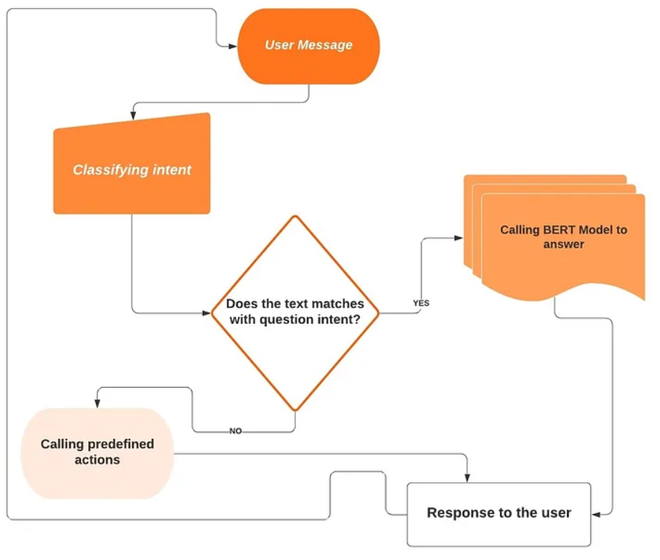
AGRIBOT architecture

Slide 12
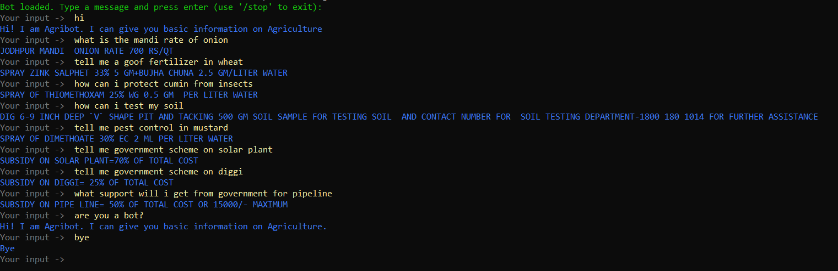
Results
Add as many slides as required to cover the following aspects:
Master class diagram
ER Diagram
User Interface Diagrams/ Use Case Diagrams
Report Layouts
External Interfaces

Slide 13
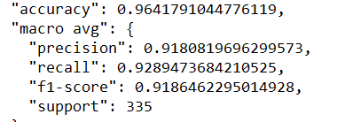
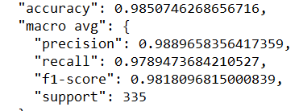
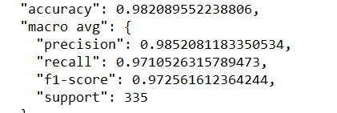
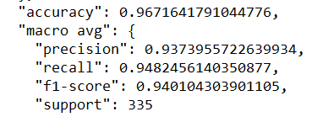
ACCURACY OF BERT AND ITS VARIANTS
BERT: It is pre-trained on large amounts of unlabeled text data and then fine-tuned for specific natural language processing (NLP) tasks. BERT is known for its ability to capture contextual word representations by considering both the left and right context of a word.
ALBERT: It is a variation of the BERT model that focuses on reducing the model's size and computational requirements while maintaining or even improving its performance. ALBERT achieves this by applying parameter-sharing techniques and reducing the model's dimensions.
ROBERTA: It is a another variation of the BERT model. It addresses some limitations of the original BERT model and introduces improvements. RoBERTa applies a more extensive pre-training methodology, uses larger training data, and removes the next sentence prediction task. These modifications result in better performance across various NLP tasks.
XLNET: It is a language model that extends the BERT approach by considering all possible permutations of the input tokens during training. This allows XLNet to model dependencies in both directions without the need for masking tokens. XLNet achieves state-of-the-art results on several NLP benchmarks by leveraging the bidirectional context information more effectively.

Slide 14
ADVANTAGES of BERT in Rasa Framework
The implementation of BERT in the Rasa framework offers several advantages, including improved language understanding, better intent classification, enhanced entity recognition, robustness to OOV words, flexibility for fine-tuning, and support for multilingual applications. These advantages can result in more accurate, context-aware, and effective chatbot interactions, leading to better user experiences and higher performance in real-world conversational AI applications.

Slide 15
Conclusion
It's important to note that implementing BERT in the Rasa framework may also have some challenges, such as increased computational resources requirements, longer training times, and potential issues with model interpretability.
In summary, the implementation of BERT in the Rasa framework can significantly enhance the NLP capabilities of chatbots and conversational AI applications, leading to improved accuracy, robustness, and flexibility in handling user queries and generating responses. However, it's important to carefully consider the challenges and limitations of using BERT and thoroughly evaluate the performance and reliability of the integrated model.

Slide 16
Applications of bert model in Rasa Framework
Intent Classification: BERT can be used to improve intent classification in Rasa-powered chatbots or virtual assistants.
Entity Recognition: BERT can also be used for entity recognition in Rasa applications.
Dialogue Management: BERT can be used to enhance the dialogue management capabilities of Rasa chatbots.
Response Generation: BERT can also be used to generate more natural and contextually relevant responses in Rasa chatbots.

Slide 17
REFERENCES
Trang Nguyen Thi Mai and Shcherbakov Maxim. Enhancing rasa nlu model for vietnamese chatbot. International Journal of Open Information Technologies, 9(1):31–36, 2021.
Yurio Windiatmoko, Ahmad Fathan Hidayatullah, and Ridho Rahmadi. Developing fb chatbot based on deep learning using rasa framework for university enquiries. arXiv preprint arXiv:2009.12341, 2020.
Trung Thanh Nguyen, Anh Duc Le, Ha Thanh Hoang, and Tuan Nguyen. Neu-chatbot: Chatbot for admission of national economics university. Computers and Education: Artificial Intelligence, 2:100036, 2021.
Wistiani Astuti, Desy Pratiwi Ika Putri, Aji Prasetya Wibawa, Yulita Salim, Anusua Ghosh, et al. Predicting frequently asked questions (faqs) on the covid-19 chatbot using the diet classifier. In 2021 3rd East Indonesia
Conference on Computer and Information Technology (EIConCIT), pages 25–29. IEEE, 2021. Shalini Singh and Satwinder Singh. Effective analysis of chatbot frameworks: Rasa and dialogflow. Technical report, EasyChair, 2022.

Slide 18
Thank You

